Slide 1

URConnected
Group members: Allan Wambold, Carter Brezinski, Salim Bakri
Milestone 3, Nov 13th
https://github.com/ENSE-374/URConnected
Notes:
Carter
https://github.com/ENSE-374/URConnected

Slide 2
What are we doing?
Just a quick reminder, we are URConnected, the group that is working to build a functional forum and messaging service for the students at the University of Regina. We will be creating a web application that will allow students to get involved with other students with similar interests and classes.
Notes:
Carter
Just a quick reminder, we are URConnected, the group that is working to build a functional forum and messaging service for the students at the University of Regina. We will be creating a web application that will allow students to get involved with other students with similar interests and classes.

Slide 3
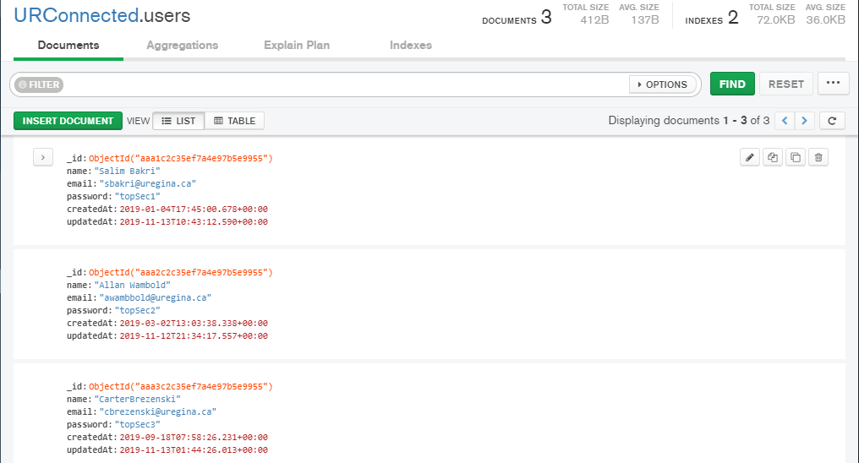
Screenshots
Notes:
Salim:
Possibly a screenshot of the backend database and what is actually being communicated to the front end.
Explanation on the backend and what is contained within it

Slide 4
Demo
Notes:
Carter
Demo, as we stated in our goals for MVP-1, “we hoped to have a decently fleshed out frontend and backend skeleton, with the possibility of being able to navigate through the website or to join groups. Though our progress can easily be shown in this demo”:
We made coded our frontend and backend well enough that we are able capable of subscribing and unsubscribing to groups, navigating to the group messages page, and back to the home page. We actually went above and beyond in the sense that we are actually able to see values being sent from the database. Sending to the database will come in the future.

Slide 5
Was MVP-1 Successful?
Our MVP-1 was very successful, we met all of our goals set out.
Due to the work we did in the previous milestone, we didn’t have to update any class or UML diagrams, only the FRD needed slight updating.
Notes:
Allan
Due to our successful planning for the previous milestone, we over-prepared so much that we didn’t have to update our FRD other than adding Other Requirements that the user must have. These minimal updates were added to the Functional Requirements Document on our github.

Slide 6
Team’s focus for the last MVP
Create an account with email verification
Successful login/logout.
Navigate through pages and groups (this includes subscribing to them)
Being able to view the member’s details in a group.
Notes:
Allan
Our focus for MVP-2 is the following:
Create accounts with university specific email verification
Being able to fully login/logout
navigate through groups (this includes joining groups)
and being able to view the member’s details in a group
is our goal for this final milestone.

Slide 7
Code Review
When making important commits for the project, we try to follow a guide on our github named ‘contributing.md’, this file basically contains recommended syntax for how you should word your commits.
Yesterday as a group we all sat down, merged our code, and ensured the code was clean and that the code followed some of the formalities we went over in class.
Some examples of this include proper naming conventions, meaningful variable names that avoid disinformation and give purpose.
Notes:
Carter
When making commits as a group, we chose to follow the guidelines of a file ‘contributing.md’ on our github; Yesterday as a group we all sat around, merged our code, and ensured that all of it was clean and followed some of the guidelines we went over in class. This included proper naming conventions in the right conditions,

Slide 8
https://github.com/orgs/ENSE-374/projects/1
Github Review
Notes:
Salim:
Speak about any updates to our Github page, the updated user stories and issues on our group Kanban Board, and how we went about splitting up group duties for this assignment.

Slide 9
Group Reflections
How did you feel about this milestone? What did you like about it? What did you dislike?
Exhausted but good, actually designing was exciting, but we’re glad to have exceeded our goals for this milestone.
What did you learn about yourself as you collaborated and worked through this milestone?
We learned we’re all capable of creating our portions individually, but making them work cohesively posed great difficulty.
How will you use what you have learned going forward?
We’ll use this knowledge and formatting to be more efficient when making MVP-2
What “stuff & things” related to this milestone would you want help with?
Your continued support, and maybe a coffee.
Notes:
Carter
Our feelings for this milestone can be described as exhausted but relieved. For Allan and I it was an interesting experience learning how to work with angular and node.js, and even with Salim’s expertise we all struggled through getting this to operate the way it did.
We learned that we were all capable of creating our assigned components on our own, but putting the pieces together and having them fit properly posed some difficulty.
We will use the knowledge and understanding we’ve learned during this milestone and keep the ball rolling for the final milestone.
Other than possible useful resources similar to what we’re doing right now, all we can ask for is your support in this project, and maybe a coffee.

Slide 10

Questions?
Notes:
Carter
Questions?

